Slide 1




Pokemon Battle Analysis
19/10/2022
DATA1030 Midterm Presentation
Taemin Huh
Brown University DSI
https://github.com/taemin-huh/data1030-project/

Slide 2
Introduction
Target variable: Win Rate (regression problem)
12 features: pkmn dataset (800 Pokemon info datapoints - Kaggle)
ID: Pokedex Number, Pokemon Name
Type: Type 1, Type 2
6 stats: HP, Attack, Defense, Sp. Atk, Sp. Def, Speed
Class: Generation, Legendary
3 features: battle dataset (50,000 Pokemon battle datapoints - Kaggle)
First Pokemon, Second Pokemon, Winner

Slide 3
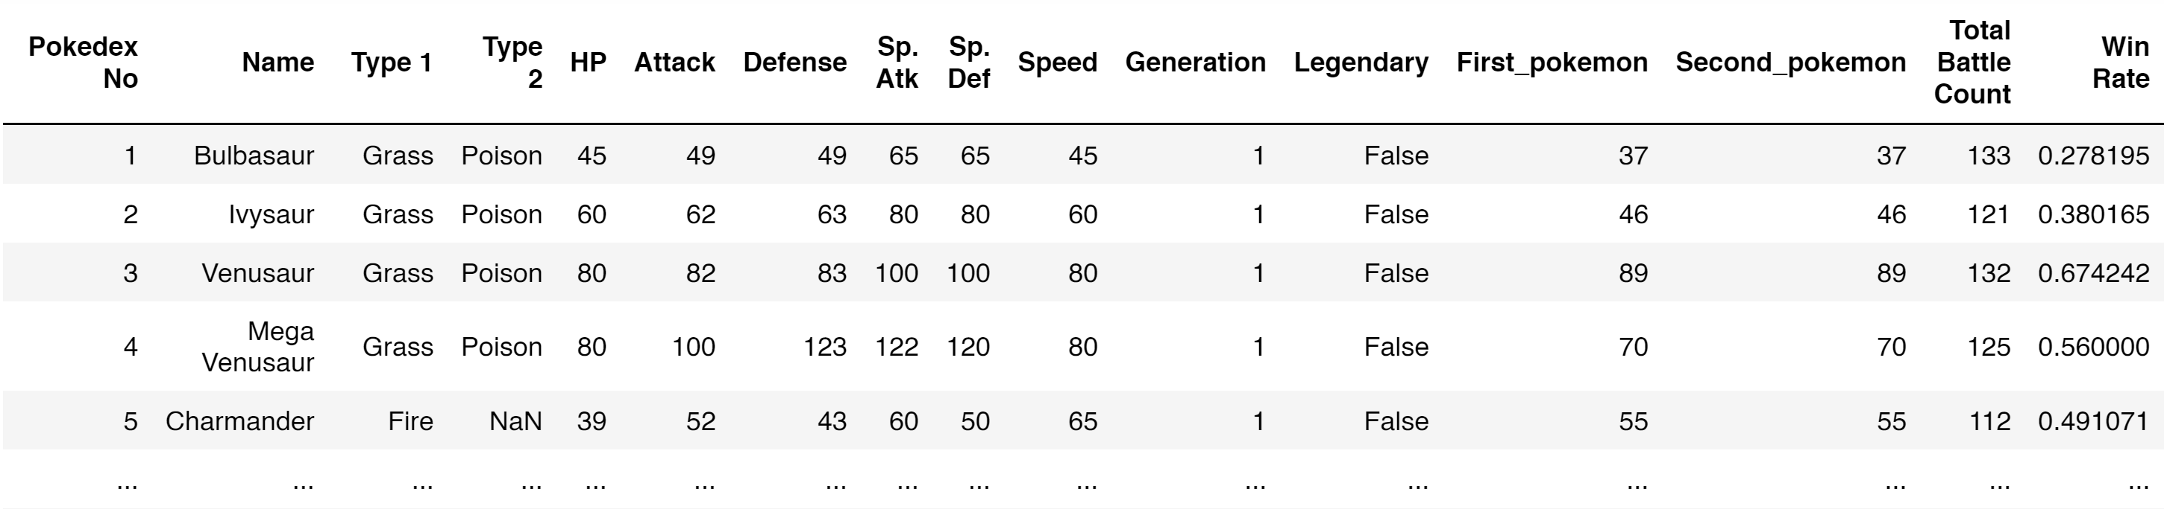
Feature Engineering
15 features total (excl. target variable)
Original columns from pkmn dataset
Feature engineered from battle dataset

Slide 4
Exploratory Data Analysis

Slide 5
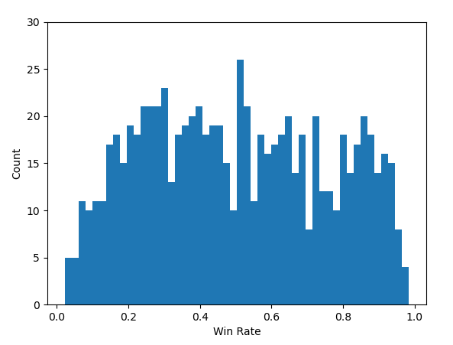
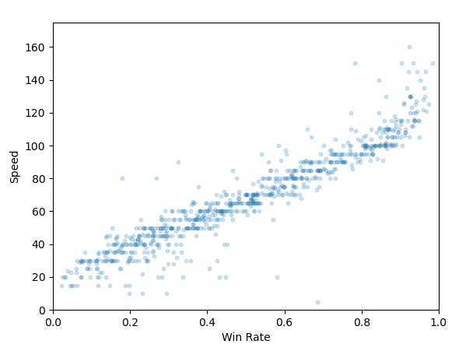
Observations
Histogram: Win Rate Distribution
Scatter Plot: Speed vs. Win Rate
Symmetrical distribution
Strong correlation (~0.94)

Slide 6
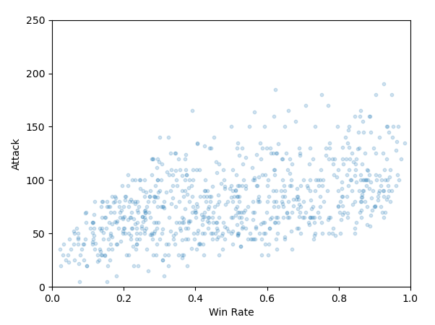
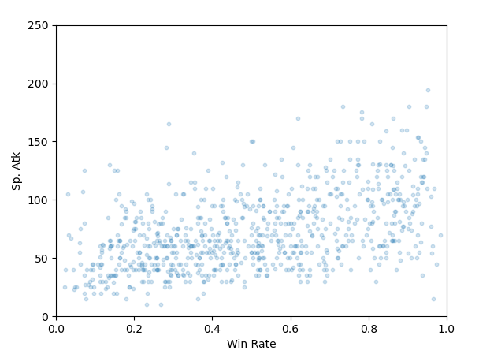
Observations (Cont.)
Scatter Plot: Attack vs. Win Rate
Scatter Plot: Sp. Atk vs. Win Rate
Some correlation (~0.50)
Some correlation (~0.48)

Slide 7
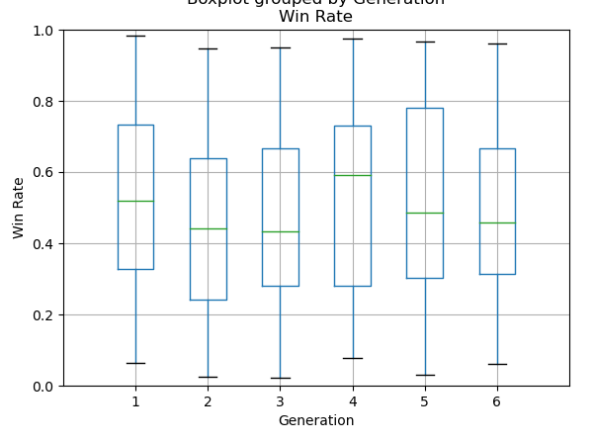
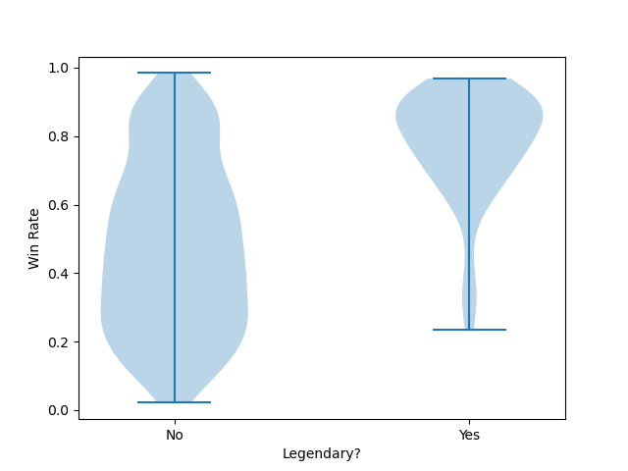
Observations (Cont.)
Box Plot: Win Rate by Generation
Violin Plot: Win Rate of Legendary vs. Not
No power inflation over generations
Some correlation

Slide 8
Pre-processing

Slide 9
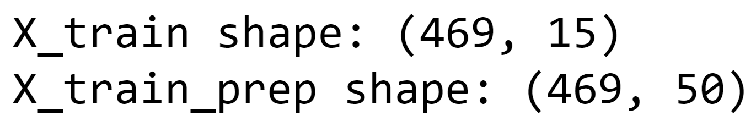
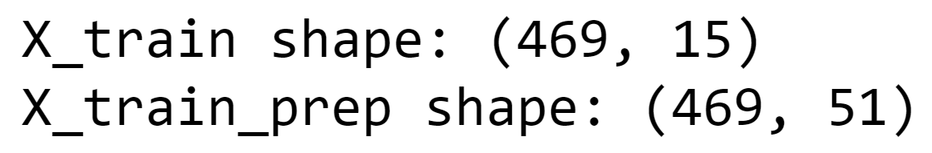
Pre-Processing
Basic split (IID, large # of datapoints)
60%/20%/20% for train/test/split
Pre-processors
OneHotEncoder: Type1 (18), Type2 (19), Generation (6), Legendary(2)
MinMaxScaler: HP, Attack, Defense, Sp. Atk, Sp. Def, Speed (0-255 each)
51 features after pre-processing (15-5+17+18+5+1)
Missing values: Name (1), Type 2 (386), Win Rate (17)
Notes:
255 is the maximum value representable by an eight-digit binary number, and therefore the maximum representable by an unsigned 8-bit byte (the most common size of byte, also called an octet)

Slide 10

Pre-Processing
Basic split (IID, large # of datapoints)
60%/20%/20% for train/test/split
Pre-processors
OneHotEncoder: Type1 (18), Type2 (19), Generation (6), Legendary(2)
MinMaxScaler: 6 stats (0-255 each), Total Battle Count (92-164)
52 features after pre-processing (15-4+17+18+5+1)
Missing values: Name (1), Type 2 (386), Win Rate (17)
Notes:
255 is the maximum value representable by an eight-digit binary number, and therefore the maximum representable by an unsigned 8-bit byte (the most common size of byte, also called an octet)

Slide 11

Thank You

